Slide 1
DUES NOTIFICATION SYSTEM
Presentation

Slide 2
Submitted By
Yash Gedam 36 8C
Yash Kumar Soni 37 8C
Yashraj Chaturvedi 38 8C
Yukta Manek 40 8C
Guided By
Mr. Prageet Bajpai Sir

Slide 3
Instructions
The Dues Notification Systems objective is to give an easier way for alerting dues. It consumes less amount of time when compared to the usual method of knowing that any students has been imposed with any dues. Even the details of every student and their different dues can be easily seen and can be checked more efficiently.
3

Slide 4
Literature review
In this presentation we are going to discuss about how dues are imposed on students and sometimes they don’t even get to know about it. There are various dues like lab dues, late fees dues, library dues, etc which are imposed on students and when the students don’t know about that, it keeps on increasing. Some students don’t even go college regularly or it is hard for faculties to contact them so that they can inform that particular student that they are imposed with some dues. Some colleges have their own website which have student login system where students can check all their details but many students forget to check regularly their dues and it keeps building up. In this project we have worked on a Dues Notification System where when a dues is imposed on a a student, they will receive a text message that he/she is imposed with any kind of dues with some amount. It is easy for admin to keep and notify every student about their dues.

Slide 5
Hardware Requirement
System : Intel3core
Hard disk : 8GB
Monitor : 14’ color monitor
Mouse : Optical mouse
Software Requirement
Operating system : Windows 7/8/10
Coding language :
Front End :- HTML, CSS, Bootstrap, JavaScript
Back End :- PHP, MySQL
Database : phpMyAdmin

Slide 6
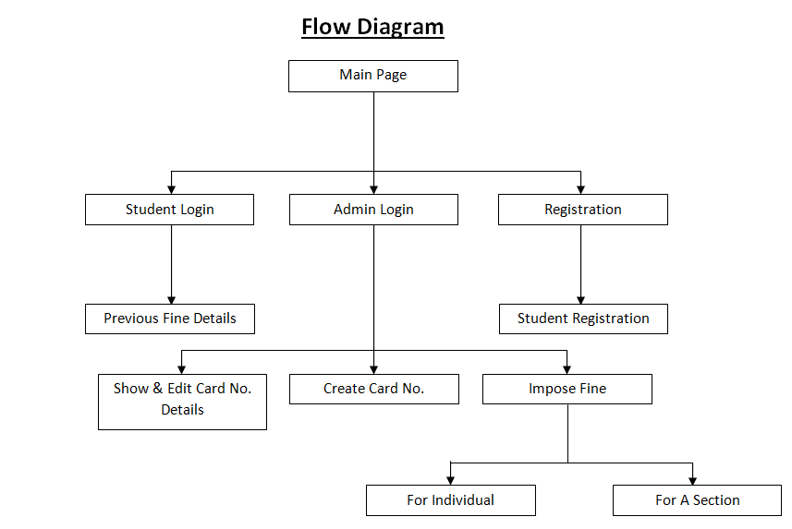
Work Flow Diagram

Slide 7
Application
This system can be used in various colleges and schools where students are imposed with dues and they should be notified about that. In school, parents will get notified when their children’s fees is dues or when a children is imposed with some dues. Usually parents doesn’t know about their children misbehavior and dues to that they are imposed with some dues, and sometimes they lie about the dues and take money for other reasons. It will be very effective as the school faculties will directly be sending message to the parent.

Slide 8
Advantages
Easy and immediate notification of imposed dues.
Efficiently organized students previous dues and details.
Reduced complexity in maintain data.
Disadvantages
We can not pay time immediately when the dues is imposed, students have to go student section to pay the dues.

Slide 9
Conclusion
Dues Notification System is not only rewarding but is also help the admin to quickly and efficiently organize the data and impose dues on the students. Students will also get notified when they are imposed with any dues. The system is user-friendly and easy to use.
We hope that the user would not only enjoy this system, but also get satisfaction from finding how each and every feature of Dues Notification System is implemented.

Slide 10
Thank you

